Slide 1
Current Betas and some sample sites from which we might pilfer some design ideas or code:
SERVIR-Mekong Beta Versions of Priority Tools
Surface Water Mapping Tool
‘Eco-dash’ Project Impact Monitoring Tool
Some other GUIs
SERVIR ClimateServ
Implements user selected jurisdictions to specify area of interest
Uses a drop-down to specify ‘operation’ to order derived statistics (i.e. mean, max, min, etc.)

Slide 2
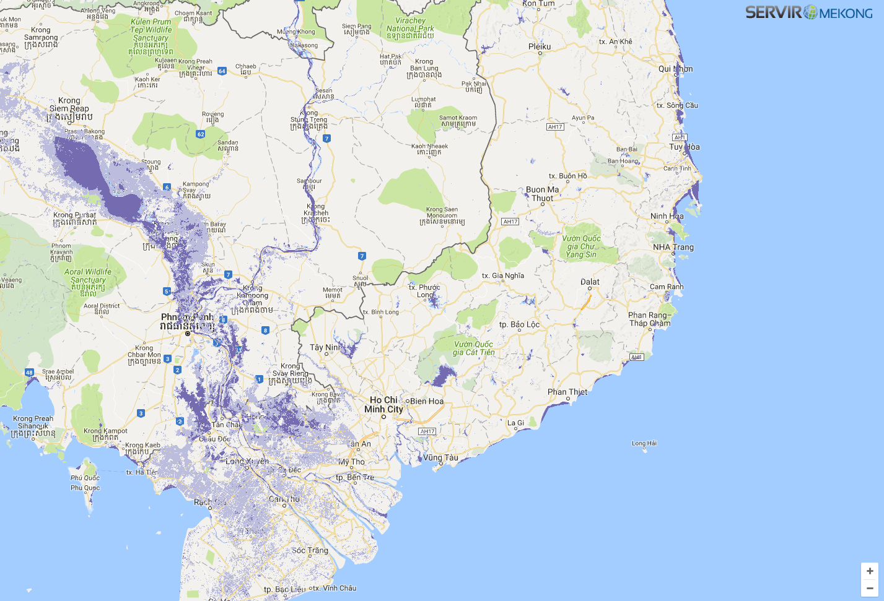
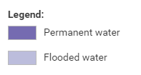
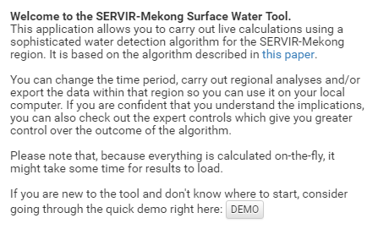
Surface Water Mapping Tool
Start

Slide 3
Surface Water Mapping Tool
Data
Specify the data you’d like to work with:
Surface water
Cloud cover
Area
Period
Reducing Functions
Output Options

Slide 4
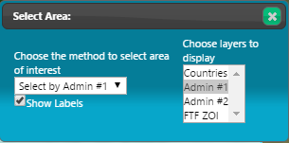
Surface Water Mapping Tool
Data
Area
How would you like to specify your area of interest:
Search/select from a list of jurisdictions
Upload a kml file
Specify an area by drawing on the map
Period
Reducing Functions
Output Options

Slide 5

Surface Water Mapping Tool
Data
Area
Period
Use the tools on the right to indicate the temporal limits of your analysis. The top slider bar is used to bracket a range of years and the lower boxes can be clicked to limit your analysis to only the selected quarters or months during each year.
Select a range of years to process:
Limit (filter) data to only the selected quarters or months:
Reducing Functions
Output Options

Slide 6
Surface Water Mapping Tool
Data
Area
Period
Reducing Functions
Use the the interface to the right to apply reducing functions to your data. You may reduce data over time (applies to stacks of overlapping pixels), over space (applies to the geographies you specified above) or both.
Apply the following to area(s) of interest:
Apply the following to a period of time:
Average
Maximum
Output Options

Slide 7

Surface Water Mapping Tool
Data
Area
Period
Reducing Functions
Output Options
Display / Print
Export

